Slide 1
Design and Implement Cloud Data Platform Solutions

Slide 2
02 | Implement SQL Server on Azure VM

Slide 3
Agenda
1
Microsoft Cloud Data Platform
5
Hybrid HA/DR Scenarios with SQL Server
2
Implement SQL Server on Azure VM
6
Design and Implement Security
3
Implement SQL Database
7
Monitor and Manage Implementations on Azure
4
SQL Database High Availability and Disaster Recovery
8
Design and Implement Database Solutions for SQL Server and SQL Database

Slide 4
In this module
Virtual machine components
Deployment scenarios
Storage Architecture
Move existing workloads
Azure deployment models
Connecting to Azure VMs
Virtual machine tiers
Domain joining VMs
Virtual machine deployments
VM best practices

Slide 5


Virtual Machine components
Compute
Storage
Networking
Flexible, Scalable CPU and memory
Standard and Premium Storage tiers
Internal/External Networking

Slide 6
Virtual Machine storage architecture
C:\
OS disk (127 GB)
D:\
Temporary disk
(Contents can be lost)
E:\, F:\, etc.
Data disks (1 TB)
Disk Cache
Azure Blob storage

Slide 7
Azure Default Blob Storage
Azure Storage Page Blobs, 3 copies
High durability
VHD disks, 1 TB per disk (64 TB total)

Slide 8
Geo-storage replication
Azure Storage Page Blobs, 3 copies
High durability
VHD disks, 1 TB per disk (64 TB total)
Geo replication
Defend against regional disasters

Slide 9
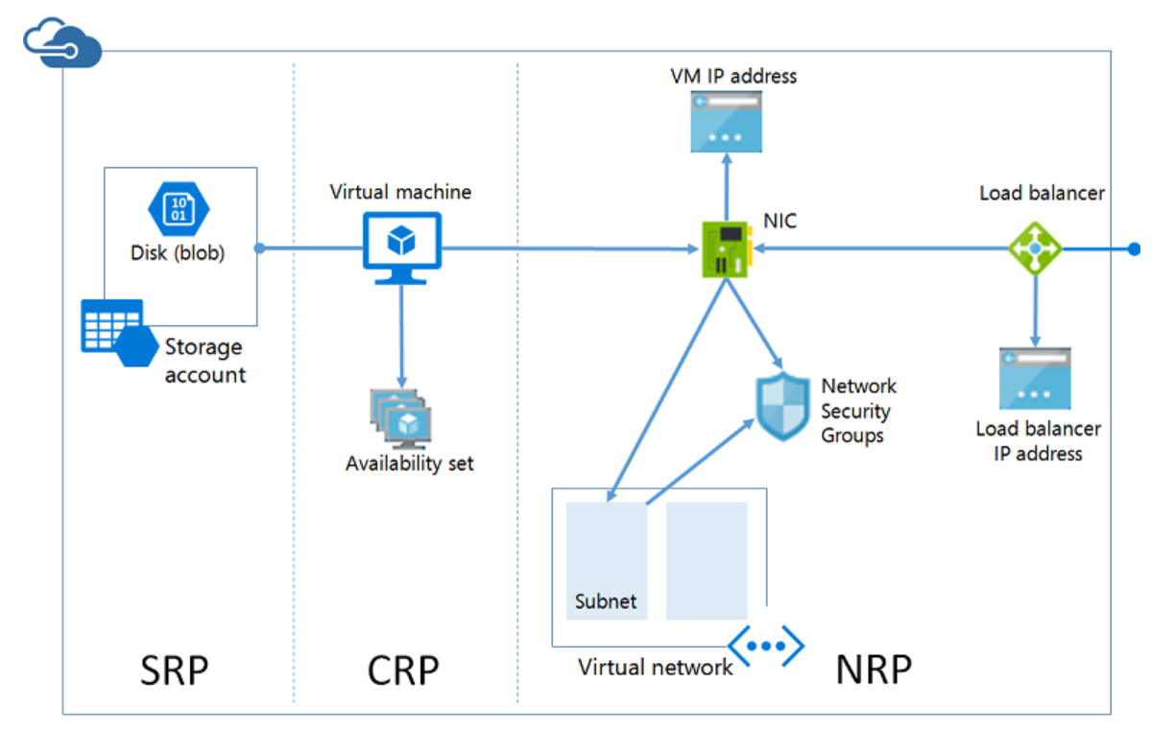
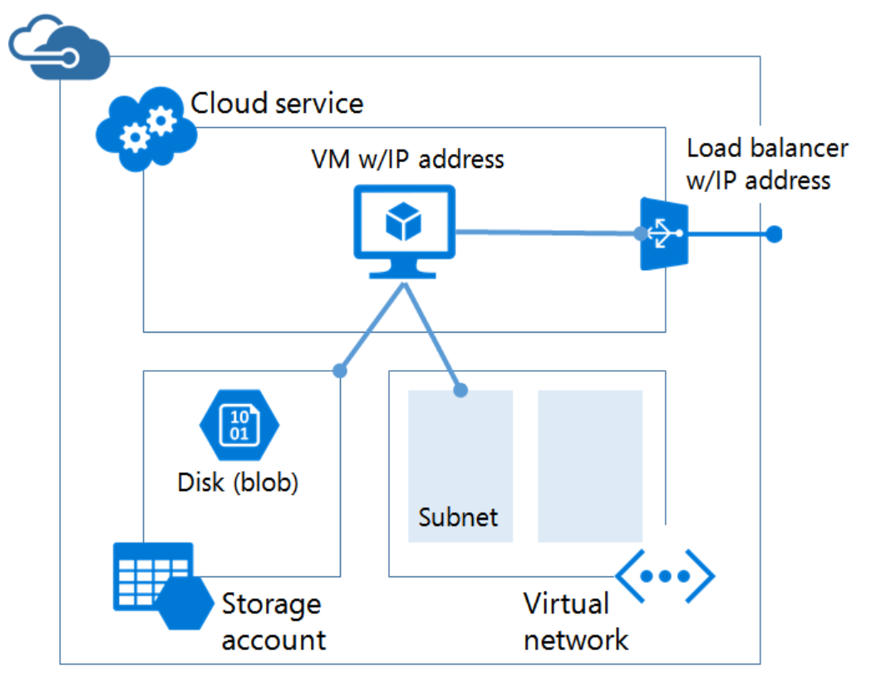
Azure deployment models
Service Manager (ASM)
Resource Manager (ARM)
Classic Deployment Model
Resource Manager Deployment Model
https://azure.microsoft.com/en-us/documentation/articles/resource-manager-deployment-model/

Slide 10

Resource manager deployment model
Storage resource provider
Compute resource provider
Network resource provider
https://azure.microsoft.com/en-us/documentation/articles/resource-manager-deployment-model/

Slide 11
Windows Azure virtual machine tiers
Basic
Standard
A0 – A4
1 – 8 CPU cores
768 MB – 14 GB RAM
Max 16 datadisks w/300 IOPS per disk
A0 – A11
1 – 16 CPU cores
768 MB – 112 GB RAM
Max 16 datadisks with 500 IOPS/disk
D1 – D14
1 – 16 CPU cores
768 MB – 112 GB RAM
Max 16 datadisks with 500 IOPS/disk
DS1 – DS14
Up to 50,000 IOPS
32 – 512 MB second
G series
2 – 32 CPU cores
28 GB – 448 GB RAM
Up to 64 datadisks with 500 IOPS/disk
GS Series
2 – 32 CPU cores
28 GB – 448 GB RAM
Up to 64 datadisks with 5000 – 80000 IOPS/disk
https://azure.microsoft.com/en-us/documentation/articles/virtual-machines-size-specs/

Slide 12
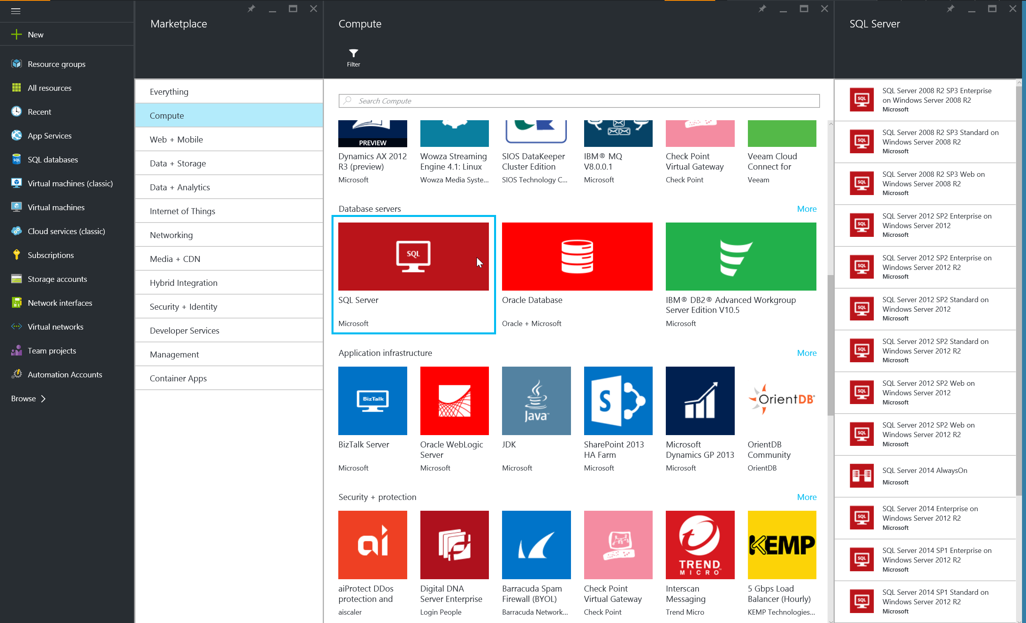
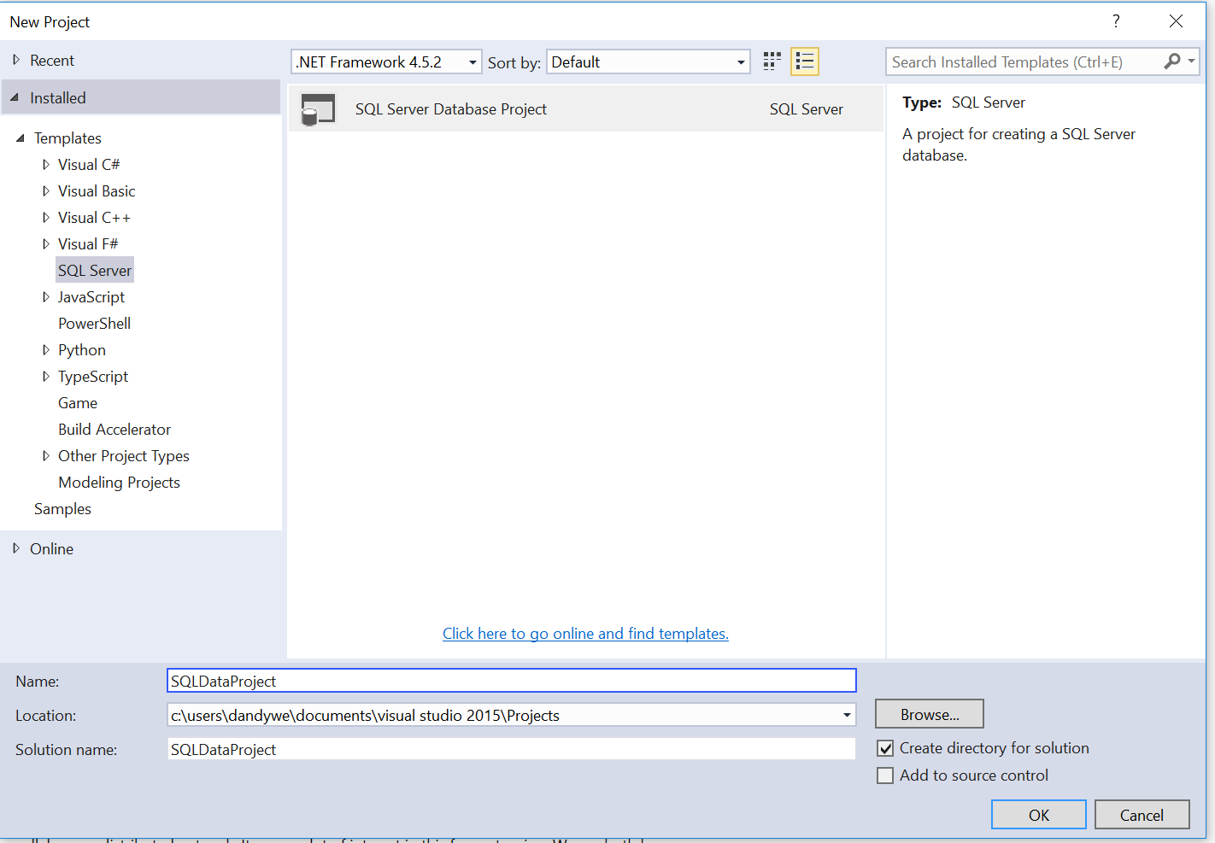
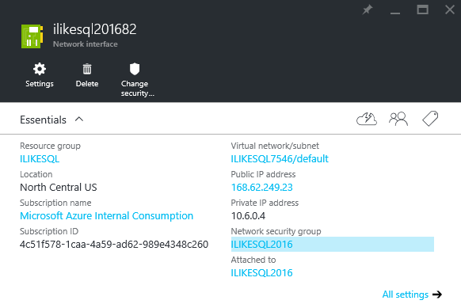
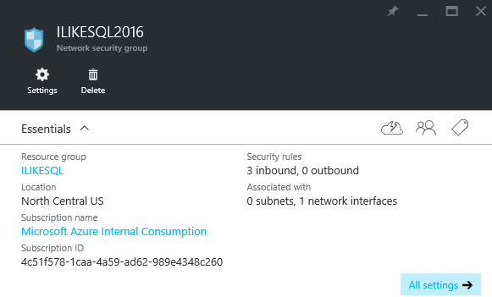
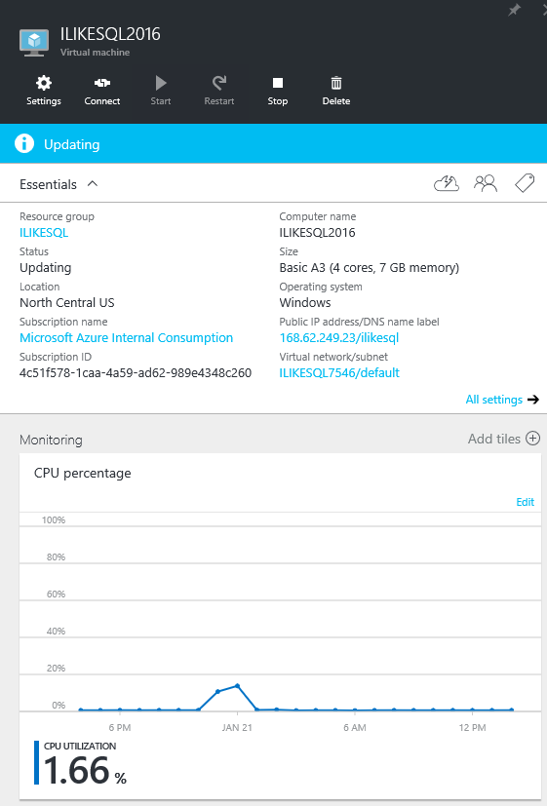
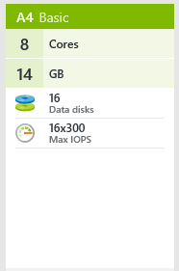
Application development deployment scenario
PROVISION
DEVELOP
DEPLOY
MANAGE
Provision new Azure VM in Azure Portal
Develop new applications using SQL Server Data Tools and Visual Studio
Configure access using Azure Portal and Windows Firewall in the VM
Manage and monitor using Azure Portal and SQL Server Management Studio

Slide 13
Demo
Manual Provisioning Virtual Machines on Azure

Slide 14
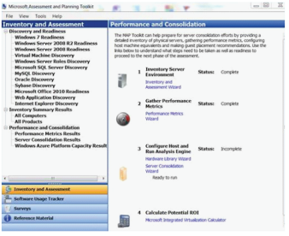
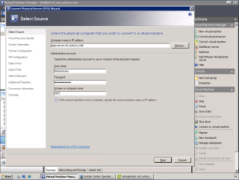
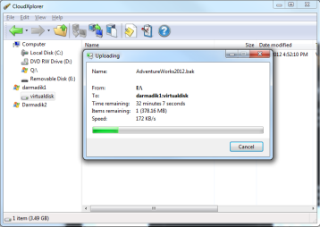
Move existing workloads to Azure VM
PROVISION
DEVELOP
DEPLOY
MANAGE
Identify database(s) to move using MAP toolkit
Convert existing physical or VM to VHD using System Center Virtual Machine Manager
Create VM based on the uploaded VHD using Windows Azure Portal
Monitor application over time using Windows Azure Portal and SQL Server Management Studio
Upload VHD to Windows Azure Storage using Windows Azure Storage Explorers¹
Configure access using Windows Azure Portal and Windows Firewall in the VM
¹ There are multiple tools to manage Windows Azure Storage http://blogs.msdn.com/b/windowsazurestorage/archive/2010/04/17/windows-azure-storage-explorers.aspx

Slide 15
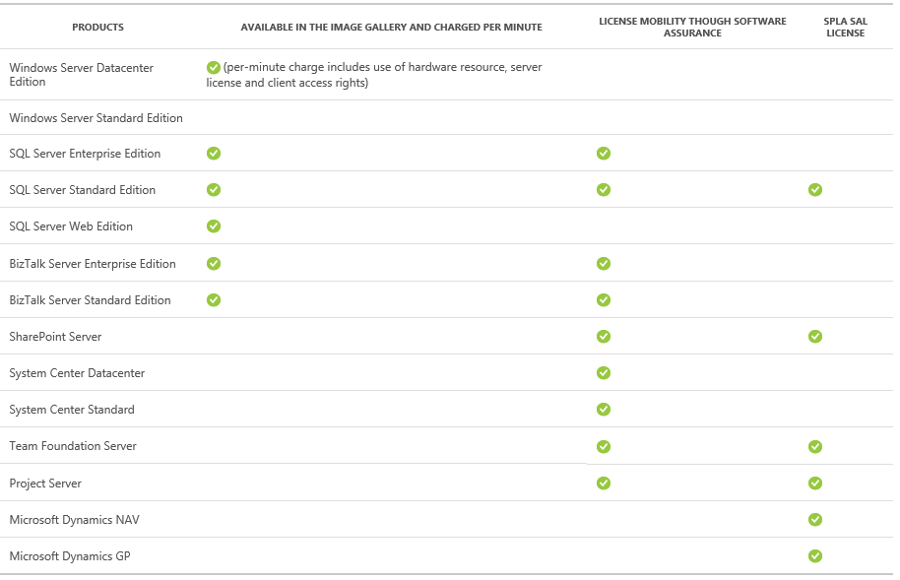
Licensing/bring your own license
Obtain SQL image from Azure VM gallery pay per use
Install or upload your own SQL Server Image

Slide 16
Demo
Deploy VM using Azure Resource Manager (ARM)

Slide 17
Hands-on Lab
SQL Server in Azure VMs

Slide 18


Connecting to Azure VMs
Virtual Machine networking
On Premises
10.0/16
Internet
VPN &
ExpressRoute
Direct Internet
Connectivity
Create subnets with private or public IP addresses
Bring your own DNS or use Azure-provided DNS
Secure with Network Security Groups ACLs
Control traffic with user-defined routes
Azure
VPN GW
Backend
10.3/16
Mid-tier
10.2/16
Frontend
10.1/16
AD / DNS
Virtual Network

Slide 19


Connectivity options and hybrid offerings
Cloud
Customer
Segment and workloads
Consumers
Access over public IP
DNS resolution
Connect from anywhere
Internet connectivity
Developers
POC Efforts
Small scale deployments
Connect from anywhere
Secure point-to-site connectivity
SMB, Enterprises
Connect to Azure compute
Secure site-to-site
VPN connectivity
SMB, Enterprises
Mission critical workloads
Backup/DR, media, HPC
Connect to Microsoft services
ExpressRoute private connectivity

Slide 20





Joining Azure VM to Domains
Azure Active Directory
3rd party apps & clouds
Microsoft’s Cloud
VMs in Azure
Active Directory
Apps in Azure
AAD App Proxy
Active Directory
Microsoft Identity Manager
Apps on-premises

Slide 21

Azure Active Directory Domain Services
Azure AD domain controller
Active Directory
Contoso VNet
Azure AD Domain Services
Contoso premises
AAD Sync
Contoso’s Azure IaaS workloads/apps
Azure Active Directory Domain Services ^{Preview}
domain controller as a service
Use LDAP, Active Directory domain join, NTLM, and Kerberos authentication
Rely on a managed, highly available service
Manage Azure virtual machines effectively using Group Policy
Active Directory

Slide 22
[optional] Demo
Active Directory Domain Services

Slide 23
Azure VM – SQL Best Practices

Slide 24
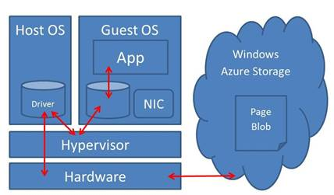
Windows Azure IO subsystem
Disks implemented as a shared multi-tenant service
Built-in triple redundancy, optional geo-redundancy
Performance less predictable than on-premises
Storage Location Service
LB
LB
Front-ends
Front-ends
Partition Layer
Geo-replication
Partition Layer
Stream Layer
Stream Layer
Intra-stamp replication
Intra-stamp replication
Storage Stamp
Storage Stamp

Slide 25
Disk Caching Best Practices for SQL Server
OS Disk
“Read Write” (default) reduces read latency for IO intensive workloads with smaller DBs (<=10 GB)
Working set can fit in disk cache or memory, reducing blob storage IO
Data disks
Cache setting depends on the IO pattern and workload intensity
Use default of “None” (disable) for higher rate of random IOs (e.g., OLTP) & higher throughput
Bypasses physical host local disks, maximizing IO rate
Consider enabling read cache for latency sensitive read heavy workloads

Slide 26
Single Data Disk Configuration
Recommended for <1 TB storage
Acceptable performance (<500 IOPs)
Minimal complexity, simpler recovery
Sample SQL IO Measurement tests for single disk:
 | Random I/O (8 KB Pages) |  | Sequential I/O (64 KB Extents) |  | Sequential I/O (256 KB Blocks)
 | Reads | Writes | Reads | Writes | Reads | Writes
IOPS | 500 | 500 | 500 | 300 | 300 | 300
Bandwidth | 4 MB/s | 4 MB/s | 30 MB/s | 20 MB/s | 70 MB/s | 70 MB/s

Slide 27
Multiple Disk Configuration
Recommended for
>1 TB DB files, OR
for higher IOPS / bandwidth requirements
Two Configuration Choices
Option 1: Use Filegroups with multiple database files, and place each database file on a separate data disk
This showed the best performance in our testing
Does not help scaling transaction log throughput and bandwidth
Option 2: Create OS volume on top of multiple data disks (e.g., OS striped volume or Windows Server 2012 storage space)
Storage spaces recommended over OS striped volumes

Slide 28
TempDB Configuration
Predictable performance OS or data disk can provide same or better performance but D: drive can be more variable, being a physical disk sharing IO with other VMs on the host. Size and performance also depends on VM size.
Configuration overhead SQL Server has to recreate TEMPDB in D: if VM goes down, SQL Server service account requires Admin privileges. If stored in a separate folder, this needs to be created at startup.
TEMPDB can be critical to application performance.
Follow tempDB IO best practices.

Slide 29
Reduce IO with Data Compression
IO intensive workloads: fewer pages ->reduced IO

Slide 30
Reduce IO with Instant File Initialization
Not default in Azure VM images
Reduces IO for
Creating a DB
Restoring a DB
Adding files to a DB
Extending file size
Autogrow, etc.
Add SQL service account to Perform Volume Maintenance Tasks security policy
Restart SQL Server
Note: Doesn’t help Transaction Log

Slide 31
Disk performance considerations
Disk warm-up
NTFS Allocation Unit Size?
Single vs. multiple storage accounts with a single VM
DO NOT SPREAD DATA FILES OF A SINGLE DATABASE INTO MULTIPLE STORAGE ACCOUNTS !!!
Data in different blobs not written at the same time
BLOBs that make up the stripe set could be out of sync
Instead:
Spread the data files across multiple disks to achieve higher IOPS / bandwidth
Note: a storage account has a limit of 80K tps

Slide 32
Performance Troubleshooting – Classic SQL Server Performance Factors
Plan change/
choice issues
Software/hardware configuration
Locking &
latching
Multi-user operations and blocking
Checkpoint & system operations

Slide 33
Troubleshooting Common VM Issues
Issue | KPIs To Monitor | Actions to Consider
CPU at or near 80% | % Processor Time (_Total) SOS_SCHEDULER_YIELD waits | Increase instance size Identify top consuming queries and tune Load balance (e.g., move DB to another instance)
Near I/O capacity limits or IO Latency Increases | Average disk reads per second Average disk writes per second Disk reads per second Disk writes per second io_virtual_file_stats PAGEIOLATCH waits SQL Server: Buffer Manager\Page Life Expectancy | Check Page Life Expectancy counter, for mem pressure. Increase instance size Identify which DB and log files have I/O bottleneck Add more data disks and separate data files if near IOPS limits per disk Tune queries to reduce reads and writes Consider enabling row or page compression
Memory resource pressure | Memory: Available Bytes Memory: Pages per second SQL Server: Buffer Manager\Page Life Expectancy Process: Working Set (for SQL Server) RESOURCE_SEMAPHORE waits | Check max server memory setting for SQL Server. Use high memory instance Identify SQL component (such as CLR, high memory grants for app queries), tune appropriately.

Slide 34
Performance Counters
Typical SQL KPIs
Max val for \Process(SQLServ)\% Processor Time
Avg val for \Process(SQLServ)\% Processor Time
Max val for \Processor(_Total)\% Processor Time
Avg val for \Processor(_Total)\% Processor Time
Max val for \SQLServer:SQL Statistics\Batch Requests/sec
Avg val for \SQLServer:SQL Statistics\Batch Requests/sec
Typical Web App KPIs
Max val for \ASP.NET Applications (_Total_)\Requests/sec
Avg val for \ASP.NET Applications (_Total_)\Requests/sec
Avg val for \Memory\Available Mbytes
Max val for \Processor(_Total)\% Processor Time
Avg val for \Processor(_Total)\% Processor Time
Avg val for \ASP.NET\Request Wait Time
Avg val for \ASP.NET\Request Execution Time
Avg val for \ASP.NET\Requests Queued
Avg val for \ASP.NET\Requests Rejected
Avg val for \ASP.NET\Requests Current
Typical User/test characteristics
Number of concurrent users
Average/Max request execution time
Number of web servers
Ramp up period, test method
Start and end time of test

